Slide 1
College of Engineering AD Migration
Kathleen Booth (ervin@illinois.edu)

Slide 2
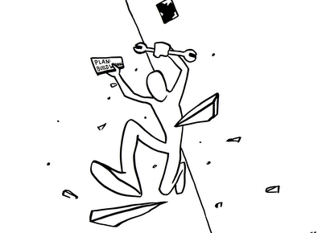
Engineering You?
Lessons Learned

Slide 3
Lesson: Allow yourself Time
Many steps will take time
2 types of steps

Slide 4
Shouldn’t skimp

Slide 5
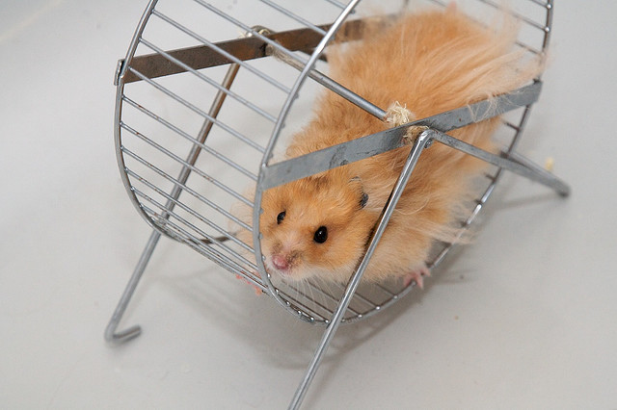
Can’t skimp
Notes:
Tedious, no way around it. Printers too. Allow plenty of time.
Hand Audit, VBS Script, map to new groups.
Clean up permissions—are there folks hanging around who shouldn’t have them?
Suggest write up: Resource/Current access (group & user)/ New access (group & access)

Slide 6
Things to do (incomplete)
* OU Structure
* OU Policies
* Group policies
* Pre-populate UofI AD (groups, computers)
* Prepare file permissions
* Migrate computers
* Delete everything from UIUC
* Relax…….

Slide 7
Lesson: Design
You have to live in it.
DESIGN WELL
For IT use

Slide 8
OU Design Constraints (Don’t read this.)
Facilitate migration to Exchange 2010 and Unified Communications
Minimize duplication of data
Structure must simplify work flow for unified IT service organization
Engineering Organizational Unit must contain all Active Directory assets for the College of Engineering
Engineering Organizational Unit must contain only Active Directory assets for the College of Engineering
Top level sub-OUs must be kept as generic as possible to reduce the need to change them in the future
Design must be flexible enough to accommodate unforeseen use cases
The purpose of all AD objects must be well documented
Design must simplify security and business policy auditing and compliance
Notes:
Wall of Text, just to have it…
Pasted from OU Design Document, to show that a lot of thought and planning went into the process.

Slide 9
Simplified OU design goal
OU Policies and design must make IT support more effective and sustainable.

Slide 10
Think about
What works, what doesn’t in UIUC?
Who needs access to what to do what?
What are objects going to be named?
Who supports what?
What is supported more like what?
  What has similar policies applied?

Slide 11
OU Structure (Simplified)
Engineering
Delegated
Desktops
MobileDevices
Servers
UsersAndGroups
Admin
Instructional
Research
Admin
Instructional
Research
Admin
Dept
Dept
Research Group
Dept
**Exchange**
Admin
Research
Instructional
Research
Instructional
Notes:
We like it. It seems to be weathering all right as things are added.

Slide 12
Lesson: You WILL forget stuff
Document
Document
DOCUMENT

Slide 13
Some Documentation Methods
AD object descriptions
AD Object Names
  Computer object:
    scheme: building-room-number
    example: mrl-270-02
Access Groups:
  scheme: unit-descriptiveresource-access
example: engradm-ipeng-access
Outside the AD (ex Wiki)

Slide 14
Lesson: GPOs
Group policies are awesome, wonderful, powerful, and dangerous
Use them.
Carefully.

Slide 15
GPO Design Constraints
One thing per GPO, clearly named
Minimize duplication
Link at the highest point in tree possible
Fewest GPOs per computer possible
New GPO, not inheritance blocking
Notes:
And no scope!

Slide 16
Group Policies
Organizational Unit
Admin OU
DesktopUpdates
Redirect Files
Dept1 OU
DeptPrinters
DeptDriveMapings
Conference Rooms
Disable Redirection
Notes:
Our theory: The fewer, the better. The less each one does, the better. The less repetition, the very much better.
We are having to develop change control. Since one GP no longer affects one department—it could conceivably hit all desktops in Engineering. That’s scary!
GPOs in many ways are the purpose to put computers in the AD. Use them. Plan them. THINK about them in advance.
May we introduce the delight that is GP Preferences?
Suggest disabling Outlook archive with the new email structure.
Change RISKY. Be CAREFUL. On the flip side, less likely to miss something.

Slide 17
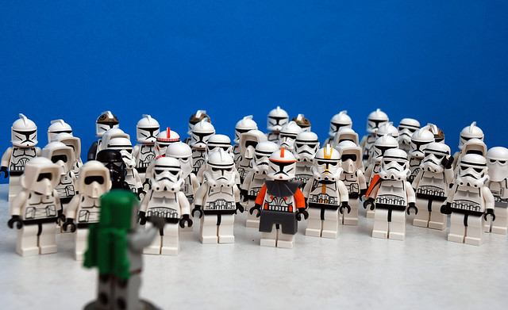
Boots on the Ground
Notes:
Done differently for different Units.
Migrating Profiles
We pretty much used Forensit (thanks to the College of Business for pointing it out to us).
Did require touching every machine. We didn’t get the remote working. Also requires you to rename machine first (if relevant).
If you use another method, beware the Outlook archive, among other Office files that may be local. So might favorites.
Comments
Overall we had a handful of problems, but very little. Fixed some of our Exchange migration issues.
It’s been quite successful with limited problems to users.
We have a script to do rename and similar, but it only worked in some places.
Warnings
If users are on XP—they need to change what domain they log into. Forensit doesn’t update that properly (it will on Win 7 if you check the box).
First logins take a LONG time sometimes. Warn your sers
If you follow us into GP Preferences you will have to patch XP to make them recognize it.
(check on warnings page to see what else)

Slide 18
Lesson: Clean Up as you Go
Permissions
Group membership
Object names
Etc

Slide 19
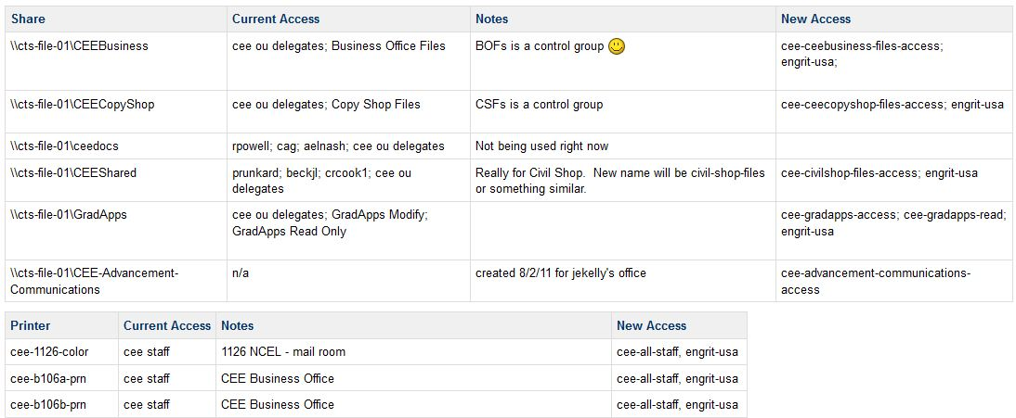
An Ugly Slide…
Notes:
An ugly side to emphasize an ugly truth.
This is a screenshot of one of our internal wiki pages. We basically went down the list of every file share, audited the current access, and decided what the access for that share would be in UOFI. Every. Single. One.

Slide 20
Lesson: Just do it
Don’t get bogged down by tools.
Use whatever works.
It’s a one-off experience

Slide 21
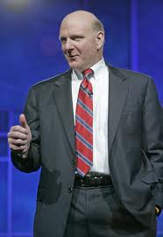
Option: Netdom
Command line tool
Pro: Can rename and domain join many machines
Con: No Profile Migration
Notes:
And on to the next method and final lesson.

Slide 22
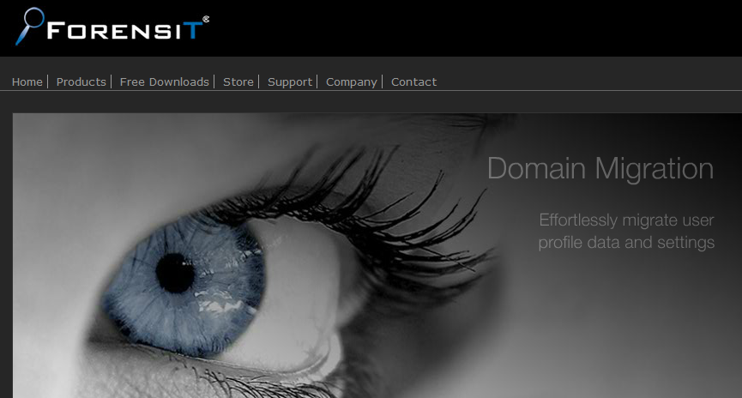
Notes:
Kudos to the College of Business, who discovered this tool.
Touched each box
Supposedly remote works but we never figured it out.
Machine in UIUC had to be renamed first.
Now..onto the 3rd method.

Slide 23
Option: Reinstall
XP to Windows 7
Notes:
And on to the next method and final lesson.

Slide 24
Mini-Lesson: Manual WILL happen
There will be edge cases
Basically: Change name, change domain.

Slide 25
Old Gotchas
Profiles & Office templates, Outlook archives, FF bookmarks, etc
UIUC\user and UOFI\user not the same thing
DFS paths that point to UIUC (recent documents, Office fails
Slow logins – first time

Slide 26
New gotchas
Run profile wizard before migration (SID history)
Make SURE you have a local admin account
Token bloat, group limitations (IT staff)
WHERE IS YOUR COMPUTER? GIVE ME YOUR COMPUTER!
This group does WHAT?

Slide 27
Bonus Lesson: Shiny tarnishes
Need a plan to keep the OU clean

Slide 28
What about UIUC?

Slide 29
Lesson*: Be diligent
Computers: Disable, delete
Groups: Empty (record!), delete
OUs: Delete
File Permissions: Remove

Slide 30
Recap
Allow enough time
DESIGN WELL
Put it into the new domain clean
  And keep it that way!
Just Migrate

Slide 31

Any Questions

Slide 32
Resources
Netdom: http://technet.microsoft.com/en-us/library/cc772217(WS.10).aspx
ForensIT: http://www.forensit.com/

